Slide 1
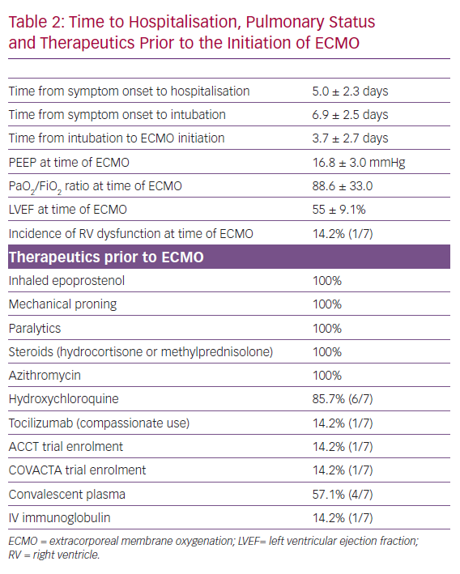
Yang Y, Rali AS, Inchaustegui C, Alakbarli J, Chatterjee S, Herlihy JP, George J, Shafii A, Nair A, Simpson L
Time to Hospitalisation, Pulmonary Status and Therapeutics Prior to the Initiation of ECMO
Citation: Cardiac Failure Review 2020;6:e17.
https://doi.org/10.15420/cfr.2020.16

