Slide 1
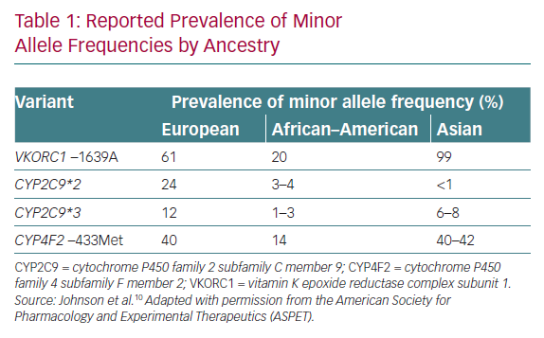
Chang GSw, Tan DSY
Reported Prevalence of Minor Allele Frequencies by Ancestry
Citation: European Cardiology Review 2020;15:e53.
https://doi.org/10.15420/ecr.2019.12

