Slide 1
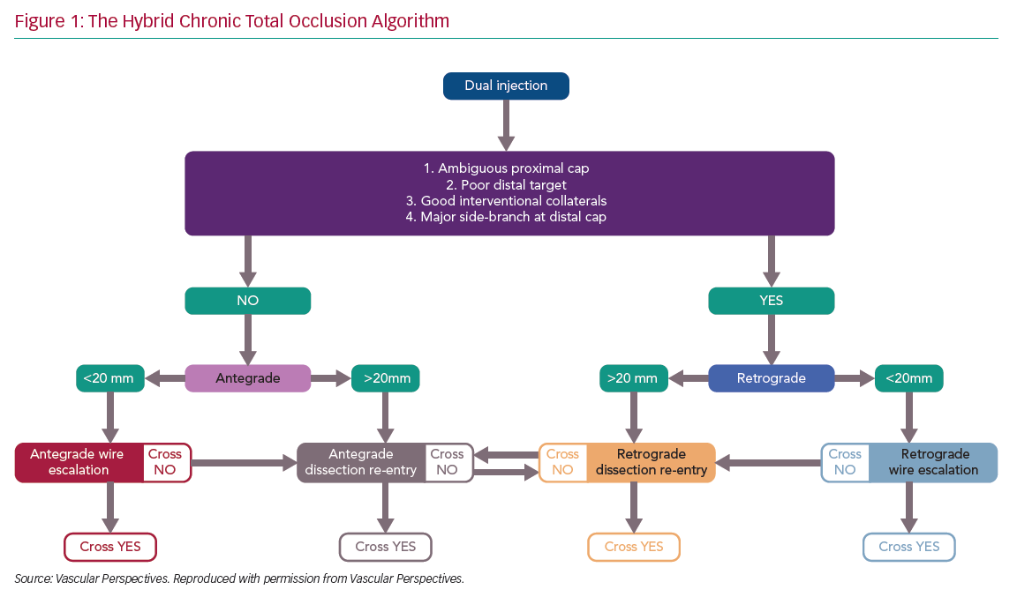
Creaney C, Walsh SJ
The Hybrid Chronic Total Occlusion Algorithm
Citation: Interventional Cardiology Review 2020;15:e08.
https://doi.org/10.15420/icr.2020.05

