Slide 1
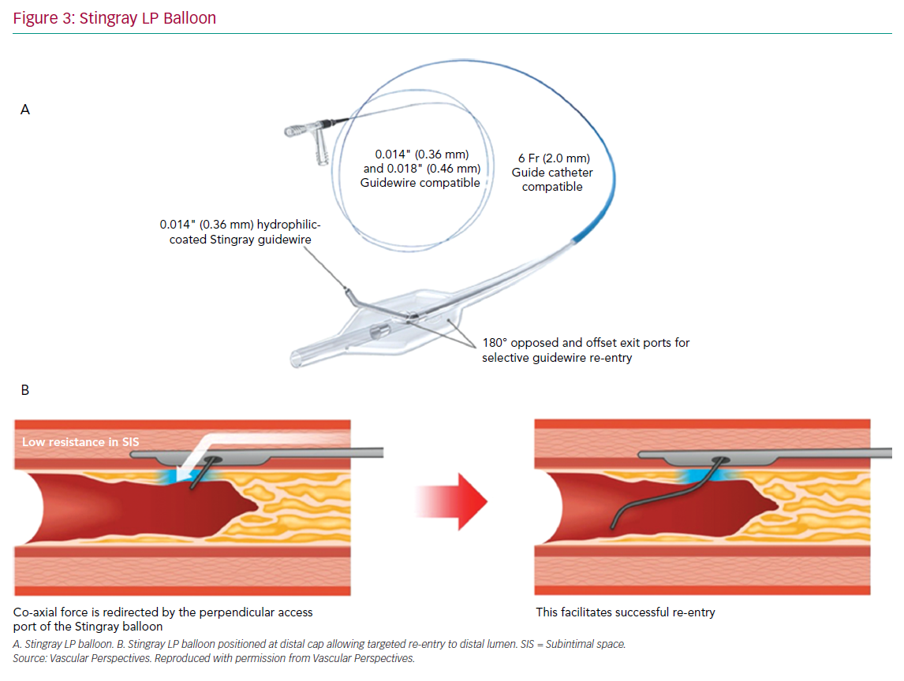
Creaney C, Walsh SJ
Stingray LP Balloon
Citation: Interventional Cardiology Review 2020;15:e08.
https://doi.org/10.15420/icr.2020.05

