Slide 1
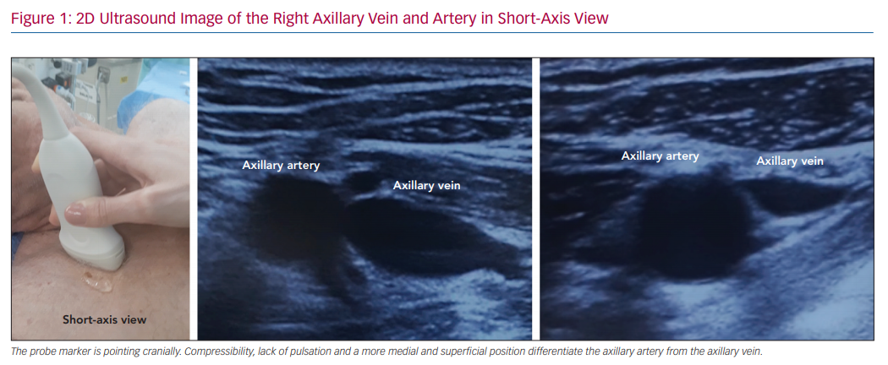
Tagliari AP, Kochi AN, Mastella B, Saadi RP, Ferrari AdL, Dussin LH, de Moura L, Martins MR, Keller Saadi E, Polanczyk CA
2D Ultrasound Image of the Right Axillary Vein and Artery in Short-Axis View
Citation: Arrhythmia & Electrophysiology Review 2020;9(2):78–82.
https://doi.org/10.15420/aer.2020.17

