Slide 1
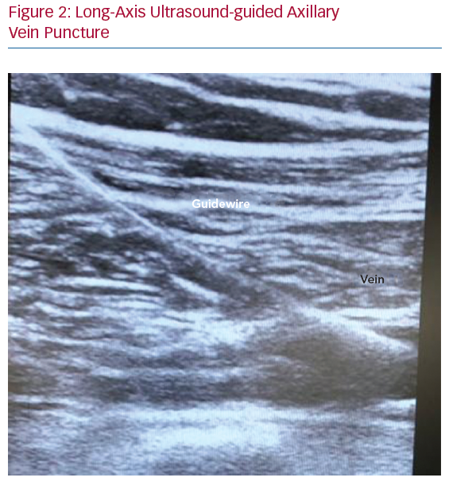
Tagliari AP, Kochi AN, Mastella B, Saadi RP, Ferrari AdL, Dussin LH, de Moura L, Martins MR, Keller Saadi E, Polanczyk CA
Long-Axis Ultrasound-guided Axillary Vein Puncture
Citation: Arrhythmia & Electrophysiology Review 2020;9(2):78–82.
https://doi.org/10.15420/aer.2020.17

