Slide 1
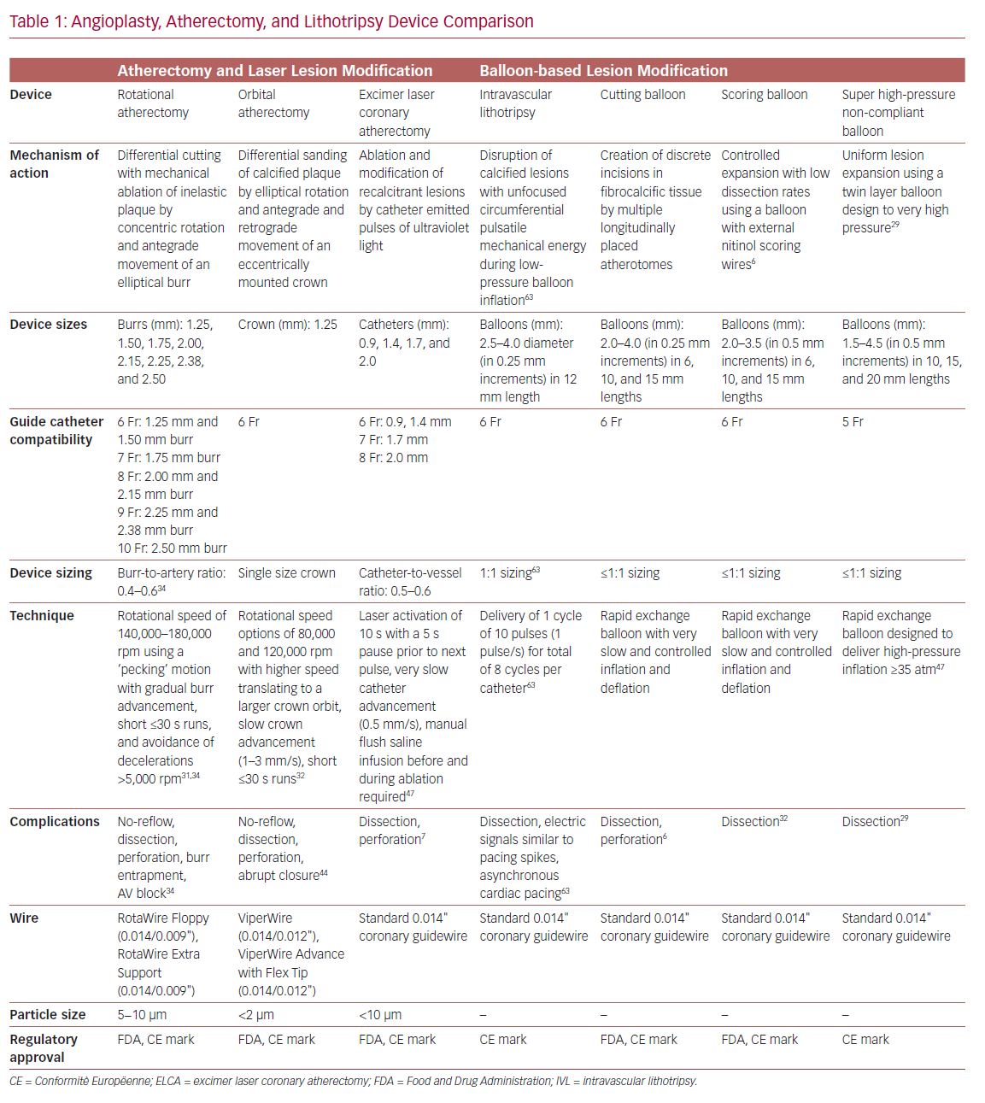
Truesdell AG, Khuddus MA, Martinez SC, Shlofmitz E
Angioplasty, Atherectomy, and Lithotripsy Device Comparison
Citation: US Cardiology Review 2020;14:e05.
https://doi.org/10.15420/usc.2020.16

