Slide 1
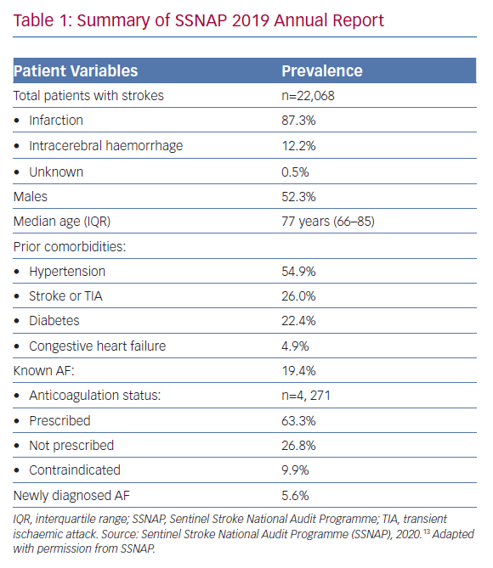
Ding WY, Gupta D
Summary of SSNAP 2019 Annual Report
Citation: Arrhythmia & Electrophysiology Review 2020;9(2):83–7.
https://doi.org/10.15420/aer.2020.03

