Slide 1
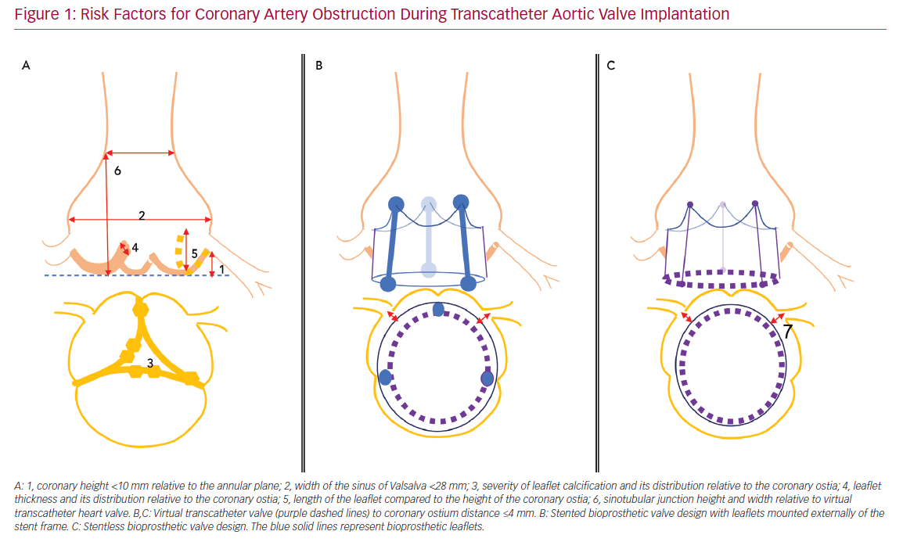
Rosseel L, Rosseel M, Hynes BG, Bel XA, Crilly E, Mylotte D
Risk Factors for Coronary Artery
Citation: Interventional Cardiology Review 2020;15:e09.
https://doi.org/10.15420/icr.2020.08

