Slide 1
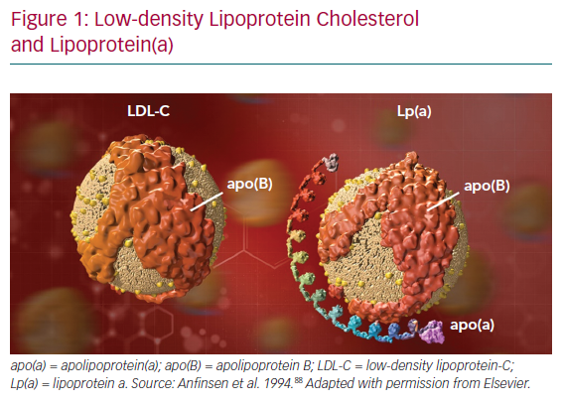
German CA, Shapiro MD
Low-density Lipoprotein Cholesterol and Lipoprotein(a)
Citation: European Cardiology Review 2020;15:e56.
https://doi.org/10.15420/ecr.2019.18

