Slide 1
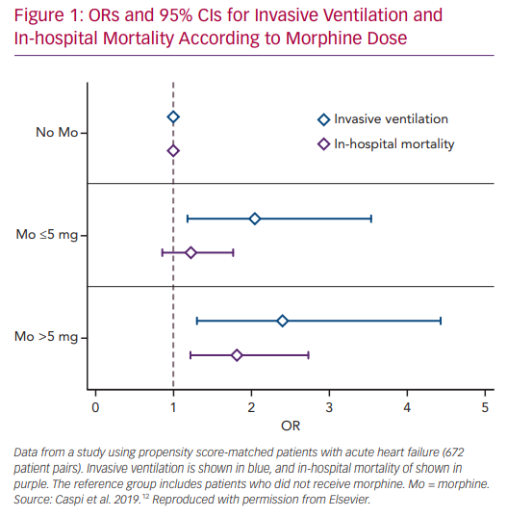
Caspi O, Aronson D
ORs and 95% CIs for Invasive Ventilation
Citation: Cardiac Failure Review 2020;6:e20.
https://doi.org/10.15420/cfr.2019.22

