Slide 1
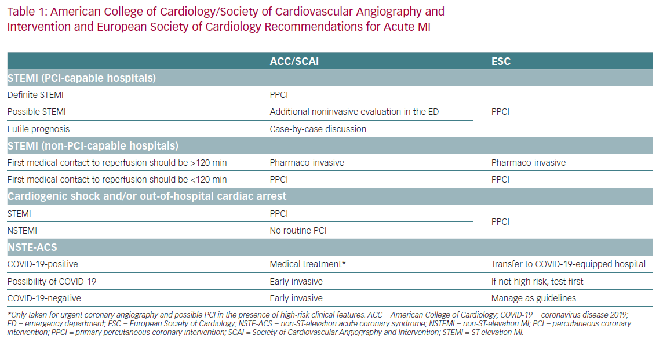
Naqvi SHR, Fatima M, Gerges F, Moscatelli S, Oz TK, Kotlar I, Babazade N, Hashemi A, Almaghraby A
American College of Cardiology/Society
Citation: European Cardiology Review 2020;15:e57.
https://doi.org/10.15420/ecr.2020.29

