Slide 1
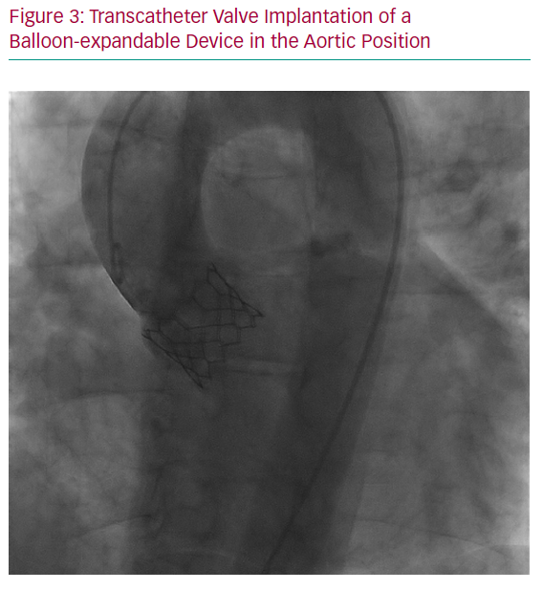
Fraccaro C, Tence N, Masiero G, Karam N
Transcatheter Valve Implantation of a Balloon-expandable Device in the Aortic Position
Citation: Interventional Cardiology Review 2020;15:e10.
https://doi.org/10.15420/icr.2020.06

