Slide 1
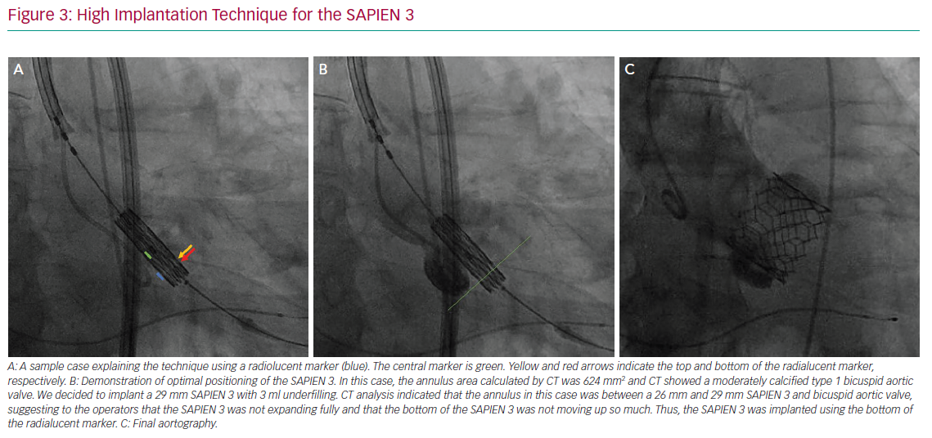
Lin SI, Miura M, Tagliari AP, Lee YH, Shirai S, Puri R, Maisano F, Taramasso M
High Implantation Technique for the SAPIEN 3
Citation: Interventional Cardiology Review 2020;15:e11.
https://doi.org/10.15420/icr.2020.07

