Slide 1
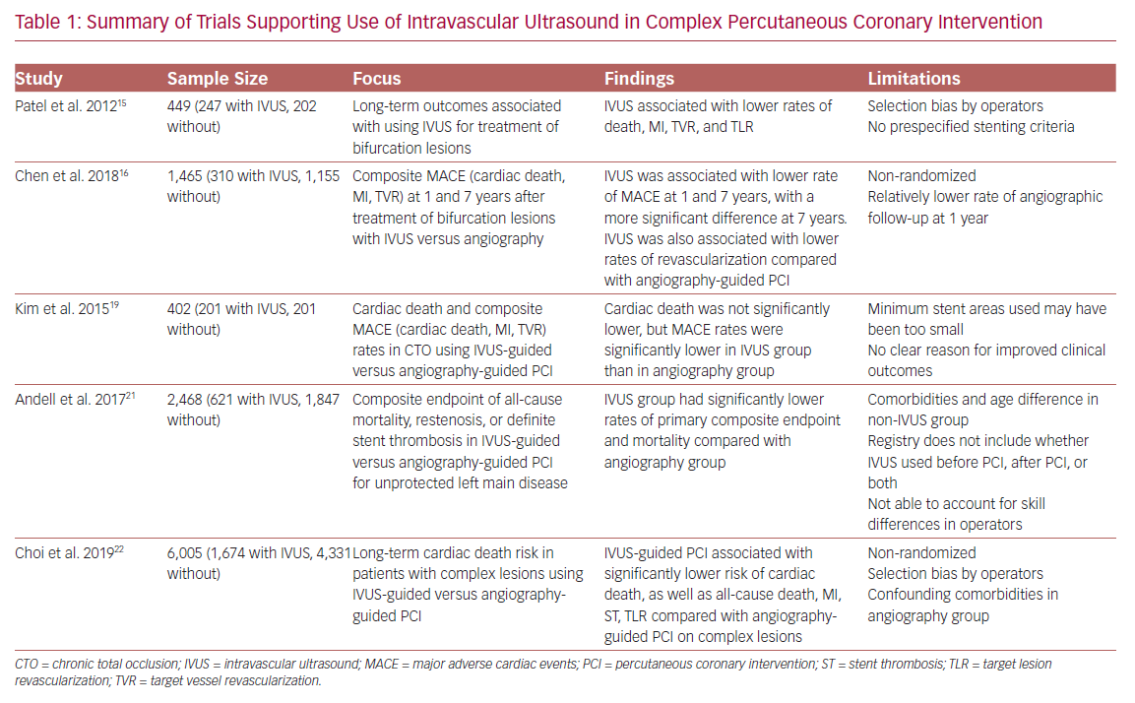
Quintana B, Ibrahim A
Summary of Trials Supporting Use of Intravascular Ultrasound
Citation: US Cardiology Review 2020;14:e07.
https://doi.org/10.15420/usc.2020.12

