Slide 1
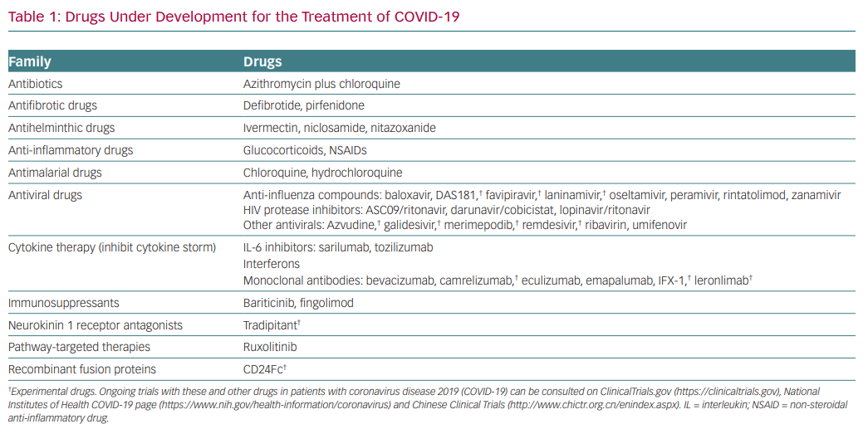
Tamargo J
Drugs Under Development for the Treatment of COVID-19
Citation: European Cardiology Review 2020;15:e59.
https://doi.org/10.15420/ecr.2020.21

