Slide 1
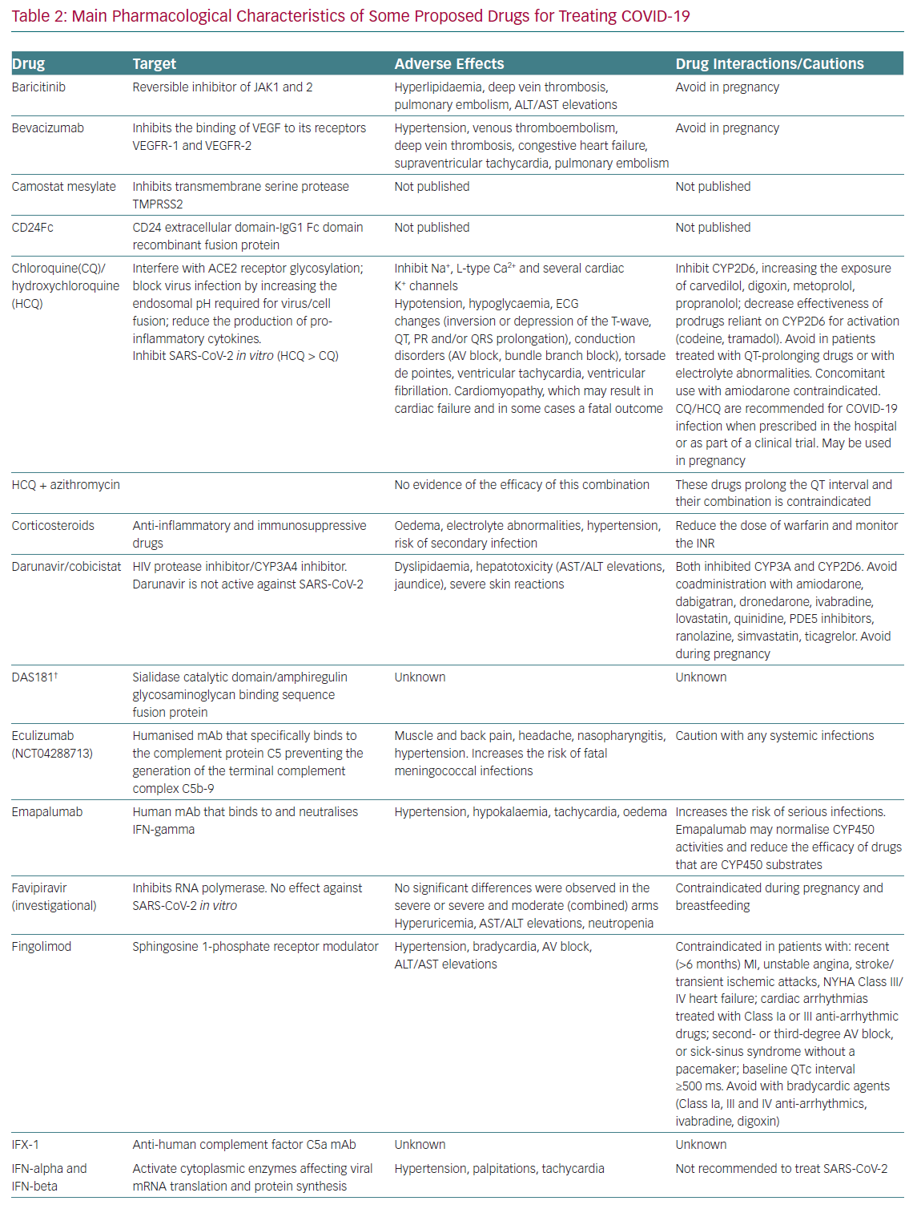
Tamargo J
Main Pharmacological Characteristics of Some Proposed Drugs for Treating COVID-19
Citation: European Cardiology Review 2020;15:e59.
https://doi.org/10.15420/ecr.2020.21

