Slide 1
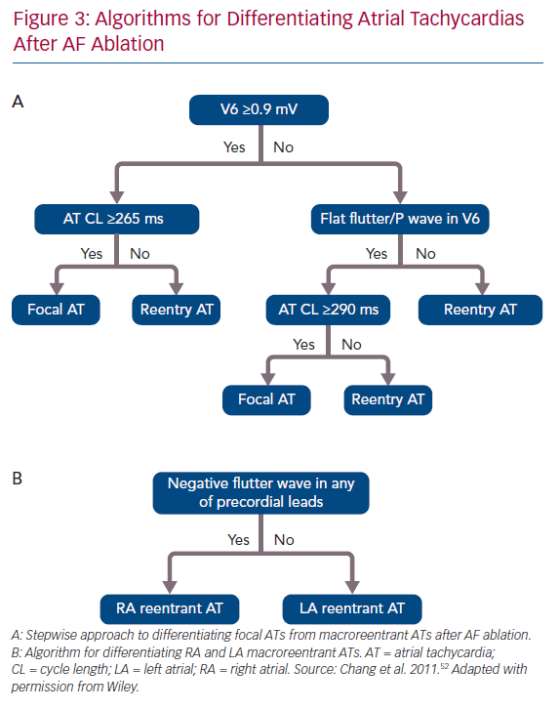
Hung Y, Chang SL, Lin WS, Lin WY, Chen SA
Algorithms for Differentiating Atrial Tachycardias After AF Ablation
Citation: Arrhythmia & Electrophysiology Review 2020;9(2):54–60.
https://doi.org/10.15420/aer.2020.07

