Slide 1
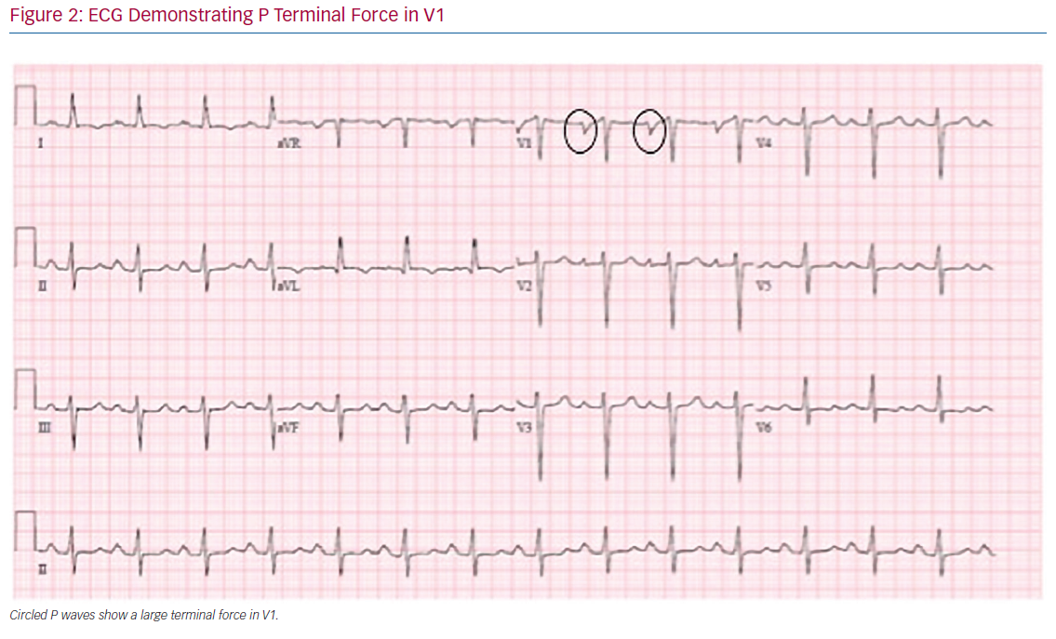
Rivner H, Mitrani RD, Goldberger JJ
ECG Demonstrating P Terminal Force in V1
Citation: Arrhythmia & Electrophysiology Review 2020;9(2):61–70.
https://doi.org/10.15420/aer.2020.13

