Slide 1
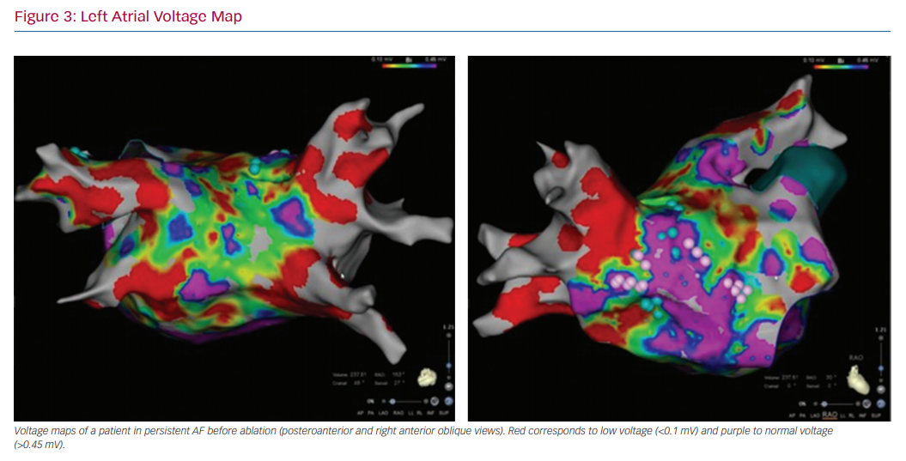
Rivner H, Mitrani RD, Goldberger JJ
Left Atrial Voltage Map
Citation: Arrhythmia & Electrophysiology Review 2020;9(2):61–70.
https://doi.org/10.15420/aer.2020.13

