Slide 1
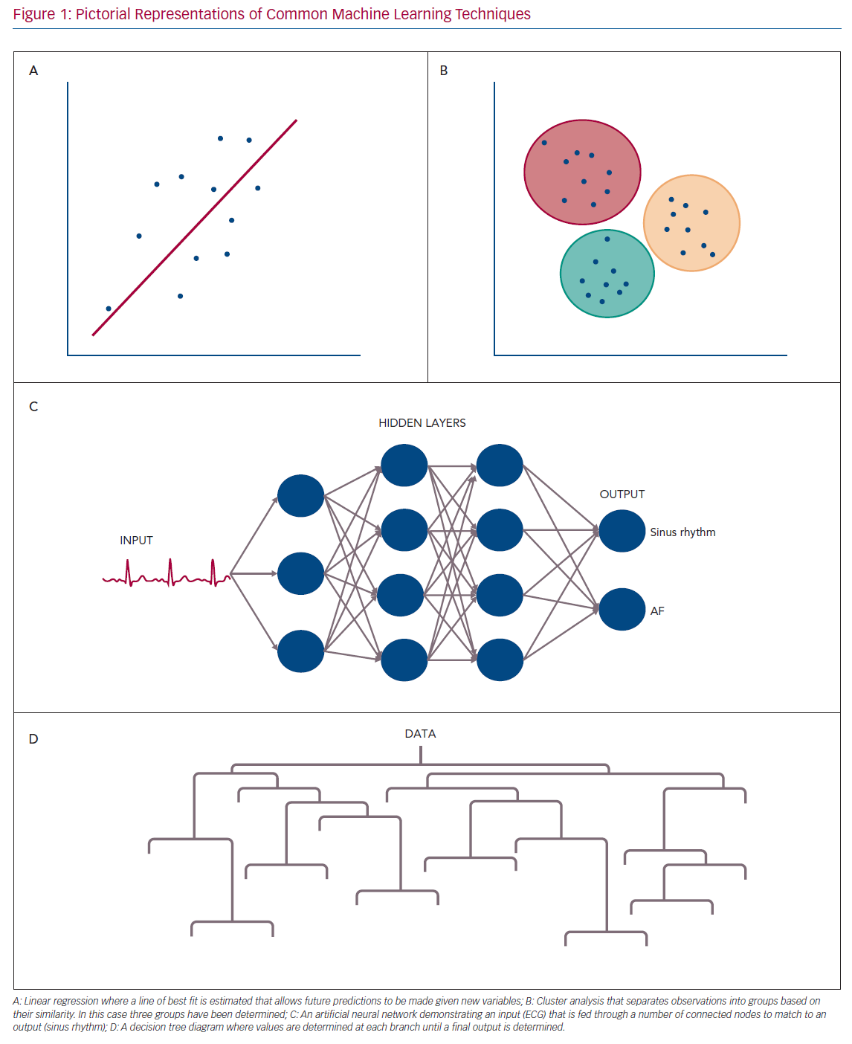
Muthalaly RG, Evans RM
Pictorial Representations of Common Machine Learning Techniques
Citation: Arrhythmia & Electrophysiology Review 2020;9(2):71–7.
https://doi.org/10.15420/aer.2019.19

