Slide 1
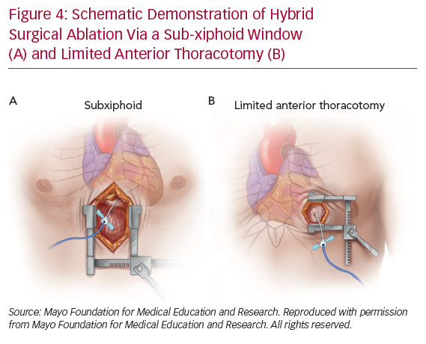
Khalil F, Siontis KC, Bagameri G, Killu AM
Schematic Demonstration of Hybrid
Citation: Arrhythmia & Electrophysiology Review 2020;9(2):97–103.
https://doi.org/10.15420/aer.2020.08

