Slide 1
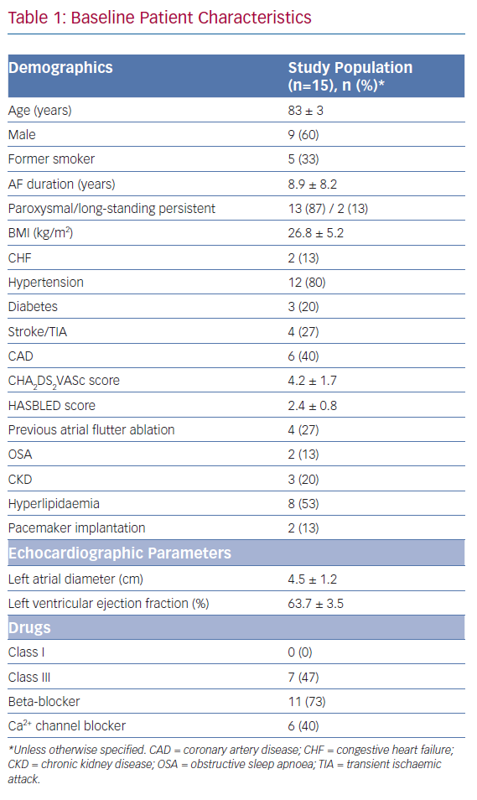
Akhtar T, Berger R, Marine JE, Daimee UA, Calkins H, Spragg DD
Baseline Patient Characteristics
Citation: Arrhythmia & Electrophysiology Review 2020;9(2):104–8.
https://doi.org/10.15420/aer.2020.18

