Slide 1
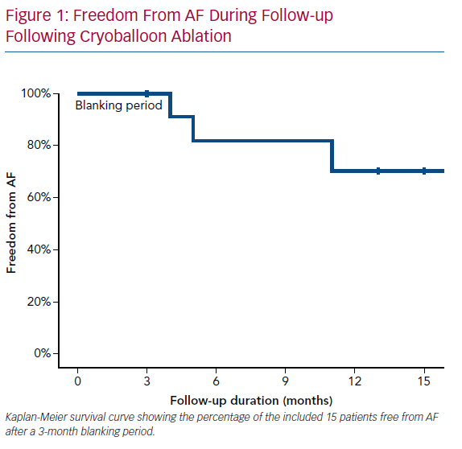
Akhtar T, Berger R, Marine JE, Daimee UA, Calkins H, Spragg DD
Freedom From AF During Follow-up Following Cryoballoon Ablation
Citation: Arrhythmia & Electrophysiology Review 2020;9(2):104–8.
https://doi.org/10.15420/aer.2020.18

