Slide 1
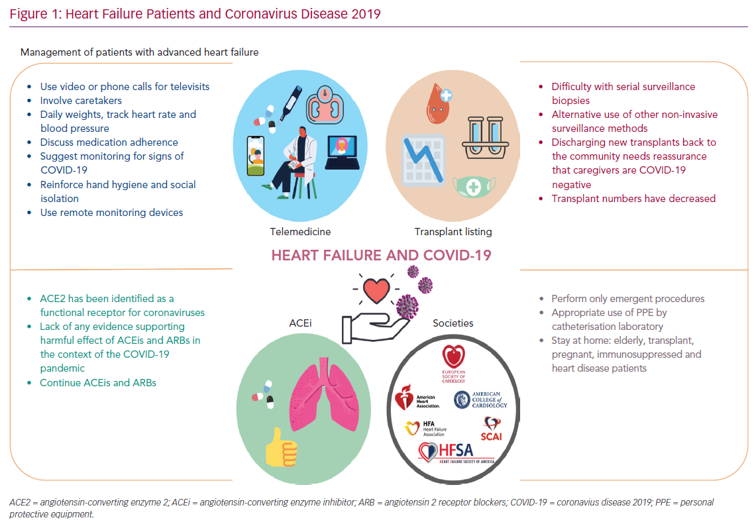
Oliveros E, Brailovsky Y, Scully P, Nikolou E, Rajani R, Grapsa J
Heart Failure Patients and Coronavirus Disease 2019
Citation: Cardiac Failure Review 2020;6:e22.
https://doi.org/10.15420/cfr.2020.09

