Slide 1
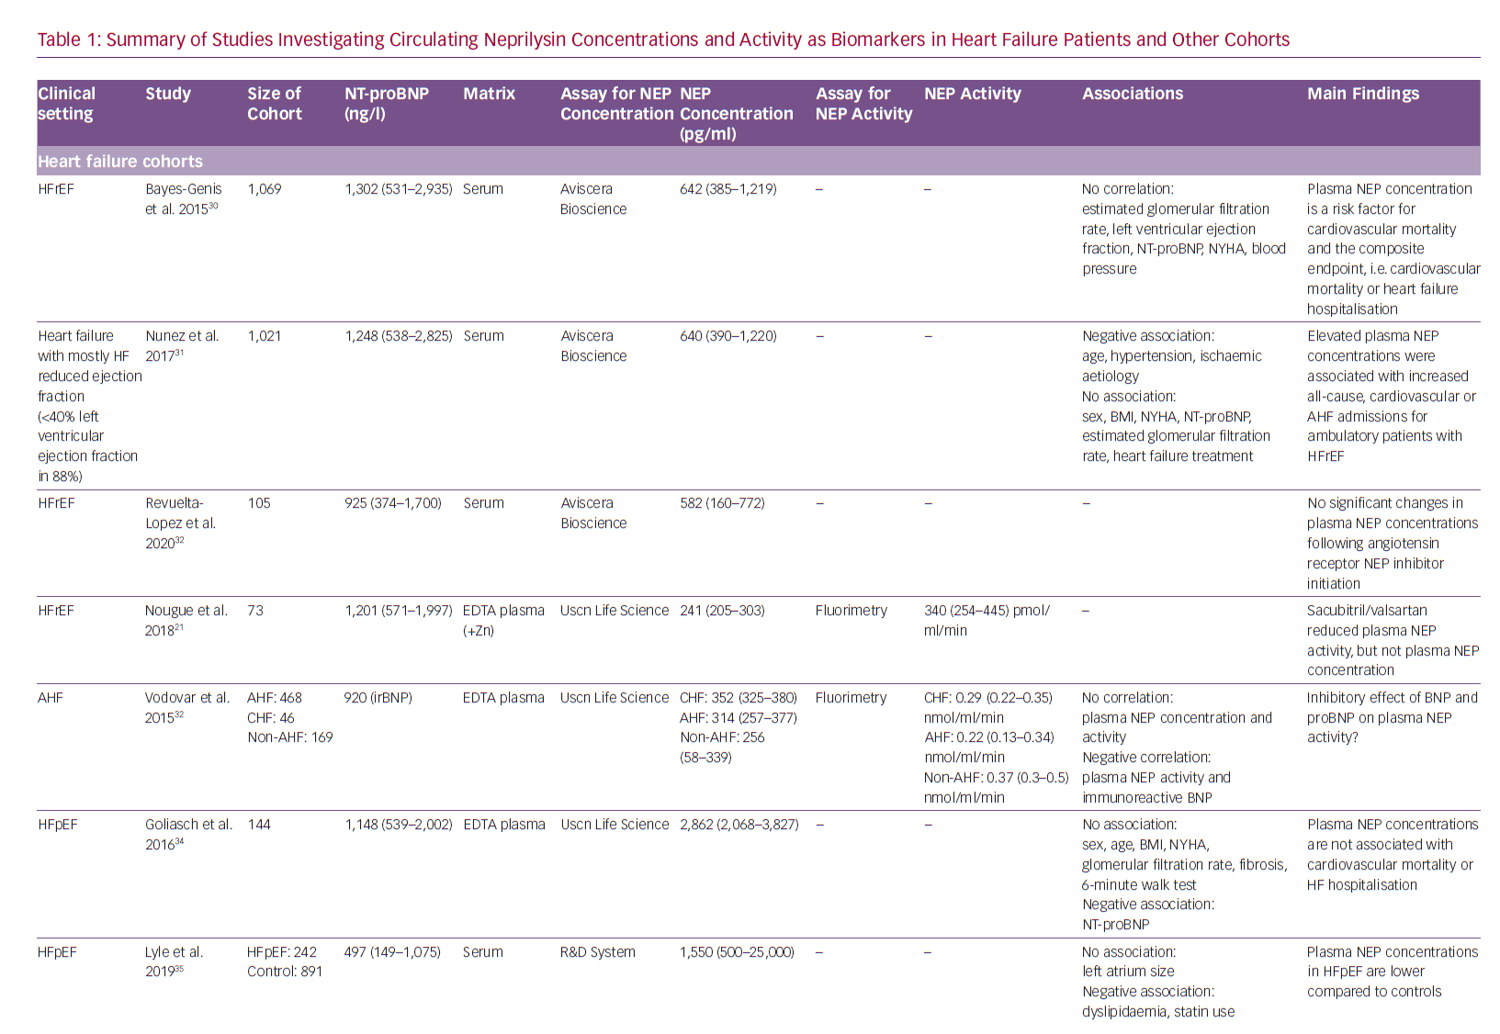
Pavo N, Prausmüller S, Bartko PE, Goliasch G, Hülsmann M
Summary Of Studies Investigating Circulating Neprilysin
Citation: Cardiac Failure Review 2020;6:e23.
https://doi.org/10.15420/cfr.2019.21

