Slide 1
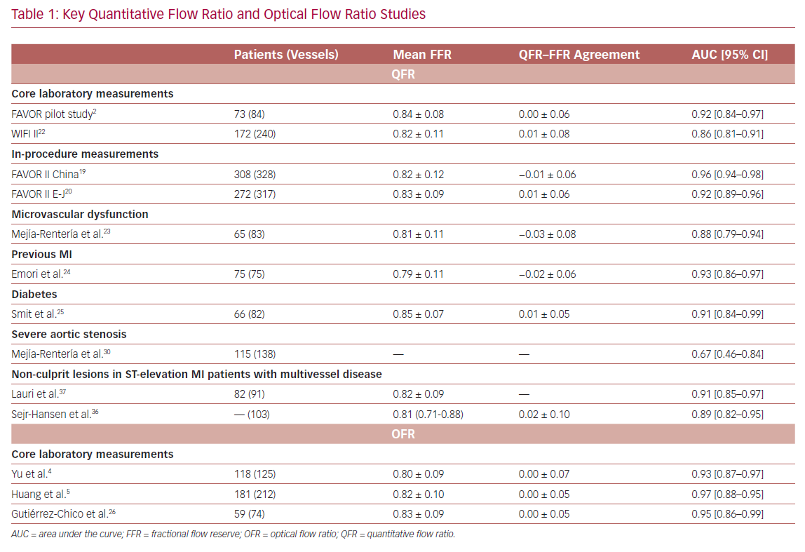
Westra J, Tu S
Key Quantitative Flow Ratio and Optical Flow Ratio Studies
Citation: US Cardiology Review 2020;14:e09.
https://doi.org/10.15420/usc.2020.09

