Slide 1
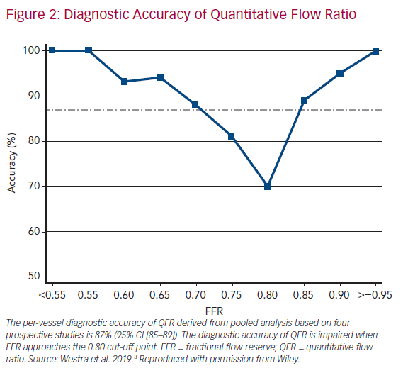
Westra J, Tu S
Diagnostic Accuracy of Quantitative Flow Ratio
Citation: US Cardiology Review 2020;14:e09.
https://doi.org/10.15420/usc.2020.09

