Slide 1

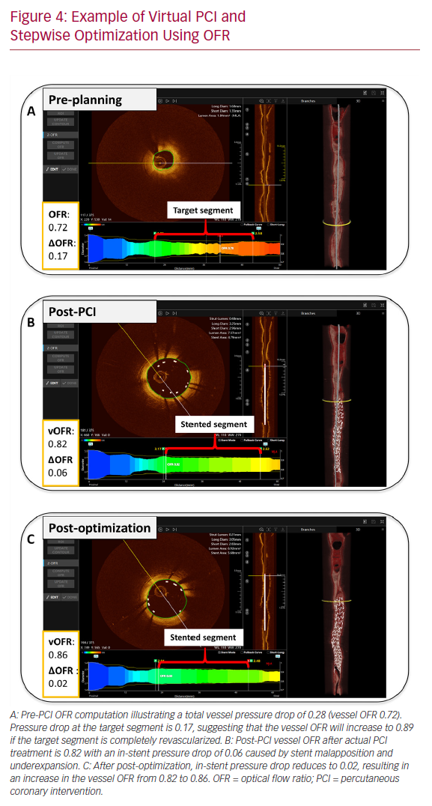
Westra J, Tu S
Example of Virtual PCI and Stepwise Optimization Using OFR
Citation: US Cardiology Review 2020;14:e09.
https://doi.org/10.15420/usc.2020.09

