Slide 1
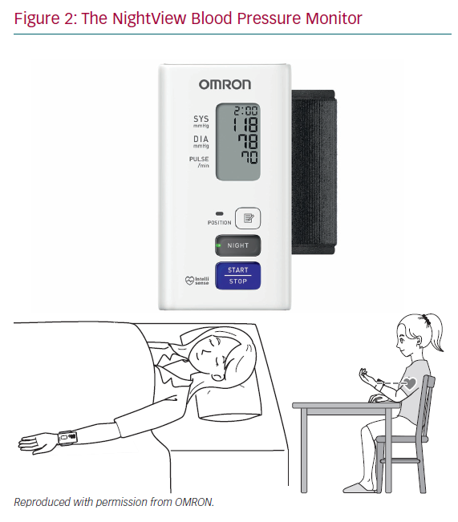
Cappuccio FP
The NightView Blood Pressure Monitor
Citation: European Cardiology Review 2020;15:e60.
https://doi.org/10.15420/ecr.2020.13

