Slide 1
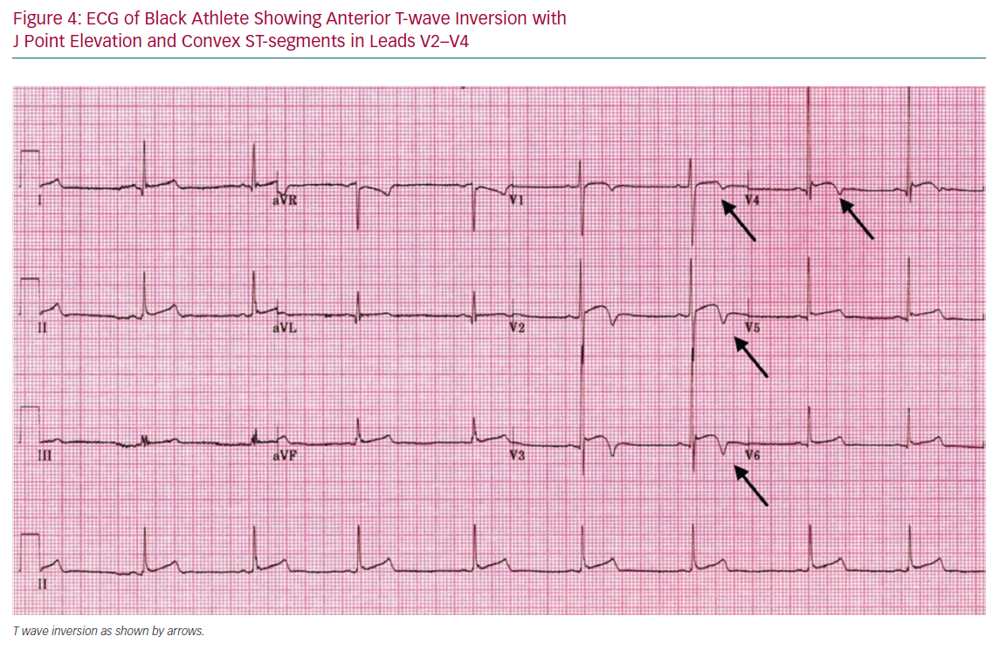
Ozo U, Sharma S
ECG of Black Athlete Showing Anterior T-wave Inversion
Citation: European Cardiology Review 2020;15:e61.
https://doi.org/10.15420/ecr.2020.01

