Slide 1

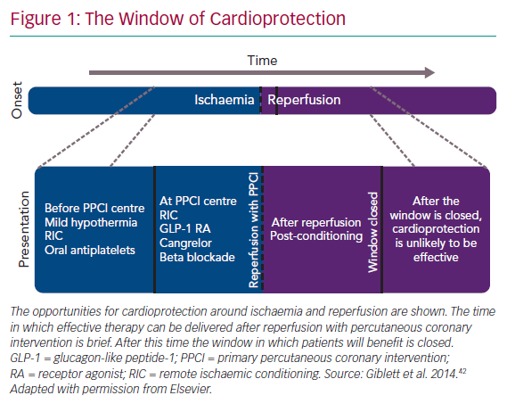
Giblett JP, Bulluck H
The Window of Cardioprotection
Citation: Interventional Cardiology Review 2020;15:e13.
https://doi.org/10.15420/icr.2020.01

