Slide 1
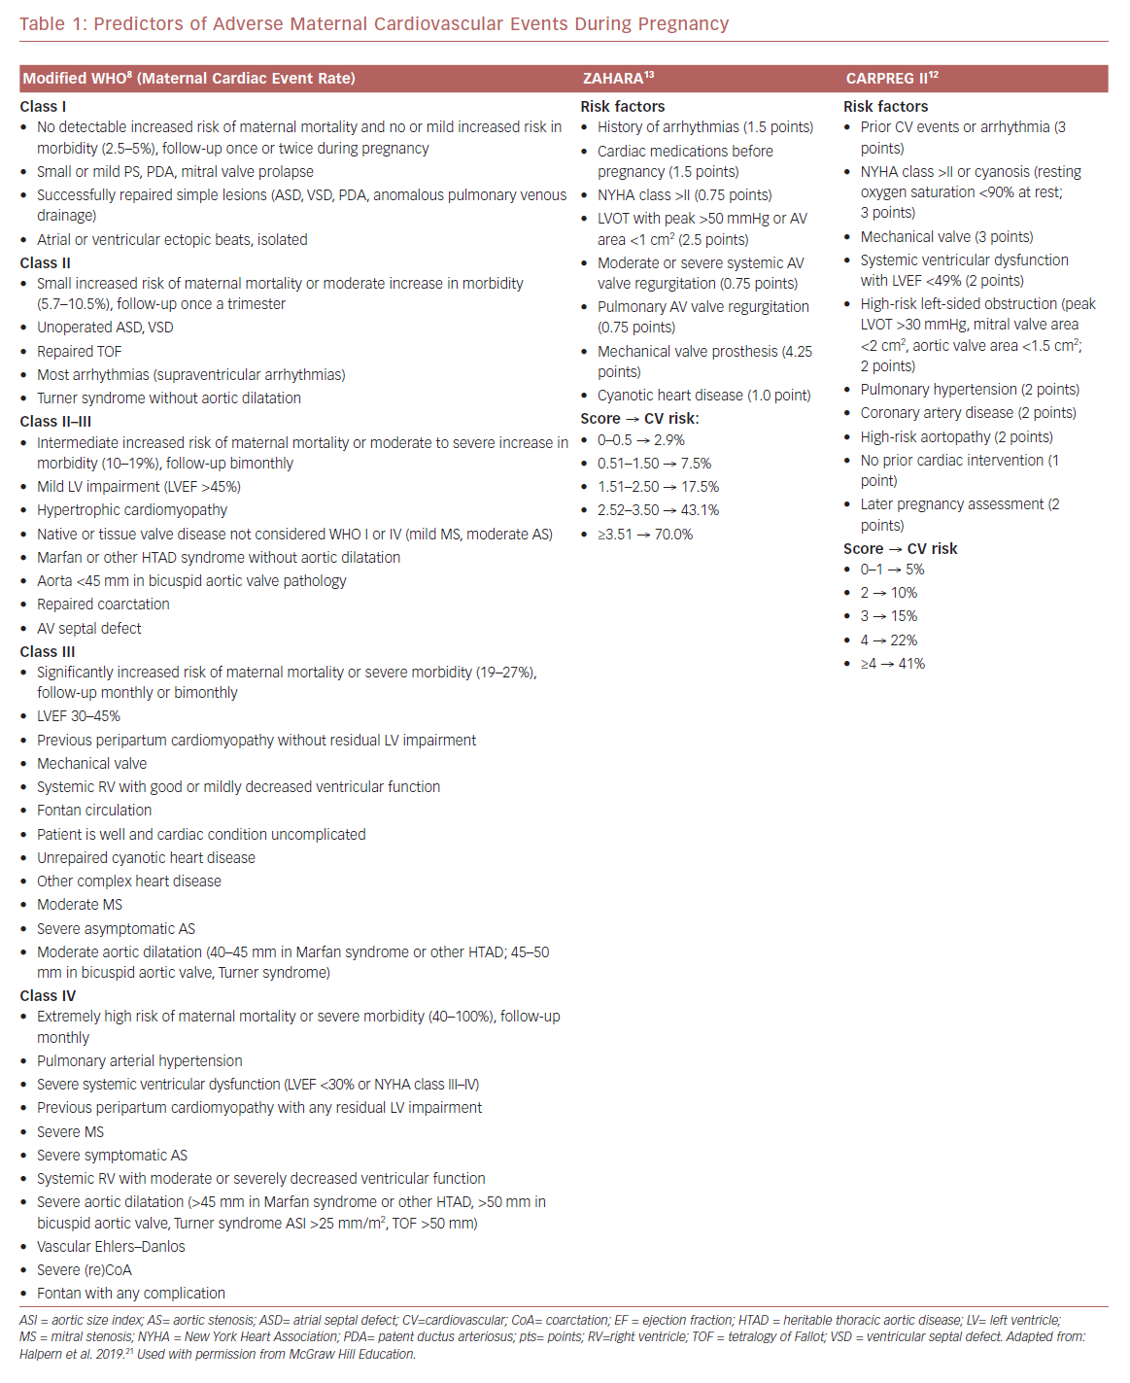
Weinberg CR, Ahmad A, Li B, Halpern DG
Predictors of Adverse Maternal Cardiovascular Events During Pregnancy
Citation: US Cardiology Review 2020;14:e10.
https://doi.org/10.15420/usc.2020.08

