Slide 1
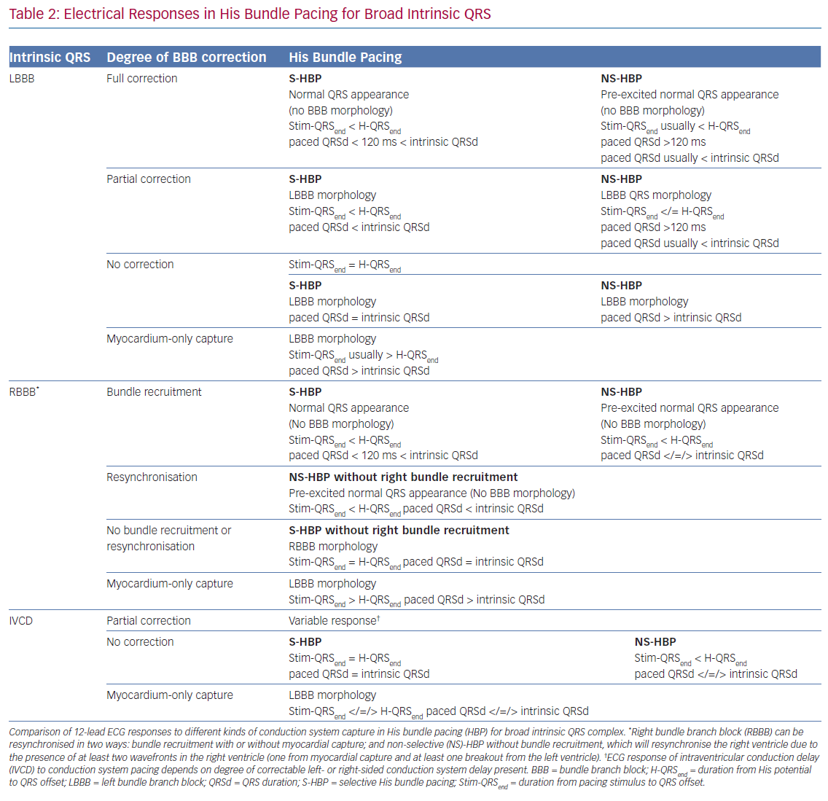
Arnold AD, Whinnett Z, Vijayaraman P
Electrical Responses in His Bundle Pacing
Citation: Arrhythmia & Electrophysiology Review 2020;9(3):136–45.
https://doi.org/10.15420/aer.2020.14

