Slide 1
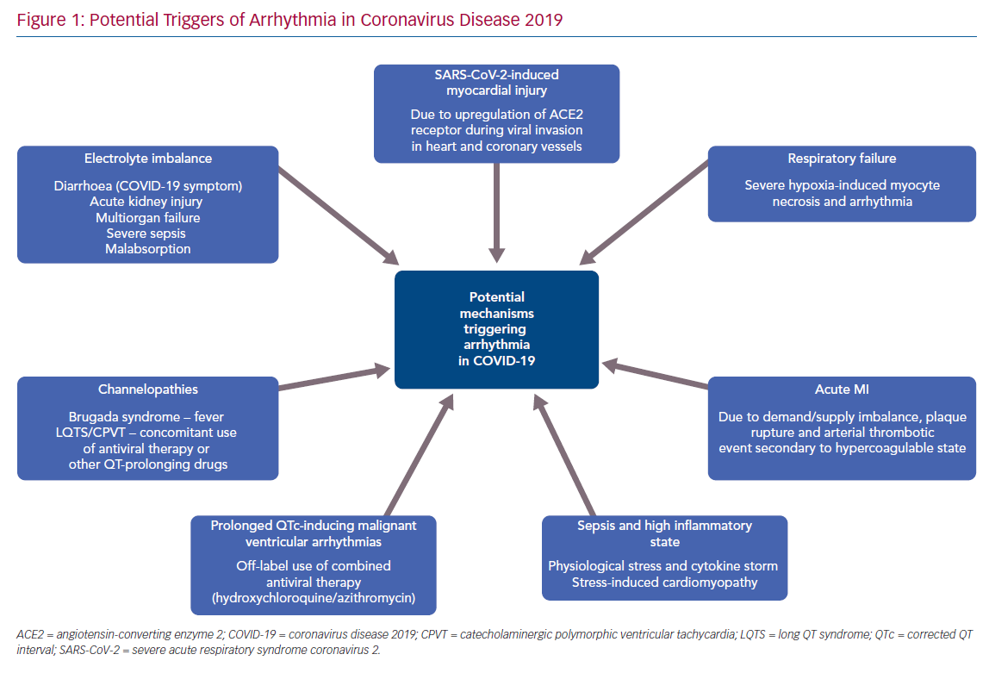
Kanthasamy V, Schilling R
Potential Triggers of Arrhythmia in Coronavirus Disease 2019
Citation: Arrhythmia & Electrophysiology Review 2020;9(3):167–70.
https://doi.org/10.15420/aer.2020.32

