Slide 1
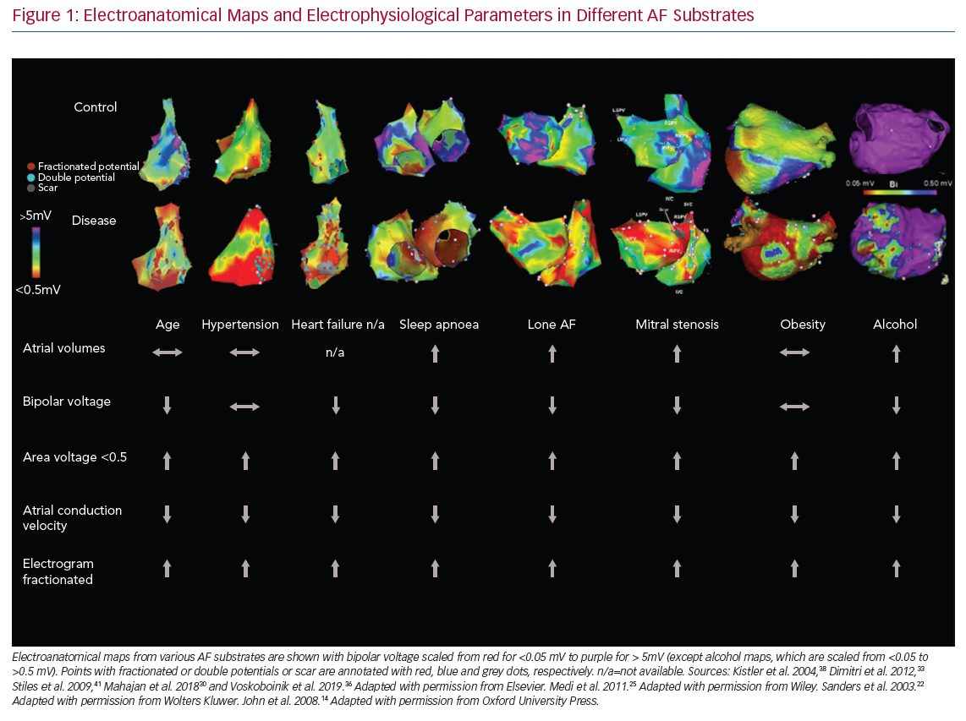
Al-Kaisey AM, Parameswaran R, Kalman JM
Electroanatomical Maps and Electrophysiological Parameters
Citation: Arrhythmia & Electrophysiology Review 2020;9(3):113–20.
https://doi.org/10.15420/aer.2020.19

