Slide 1
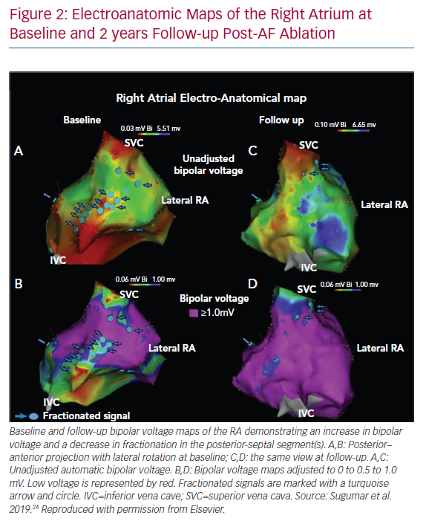
Al-Kaisey AM, Parameswaran R, Kalman JM
Electroanatomic Maps of the Right Atrium at Baseline
Citation: Arrhythmia & Electrophysiology Review 2020;9(3):113–20.
https://doi.org/10.15420/aer.2020.19

