Slide 1
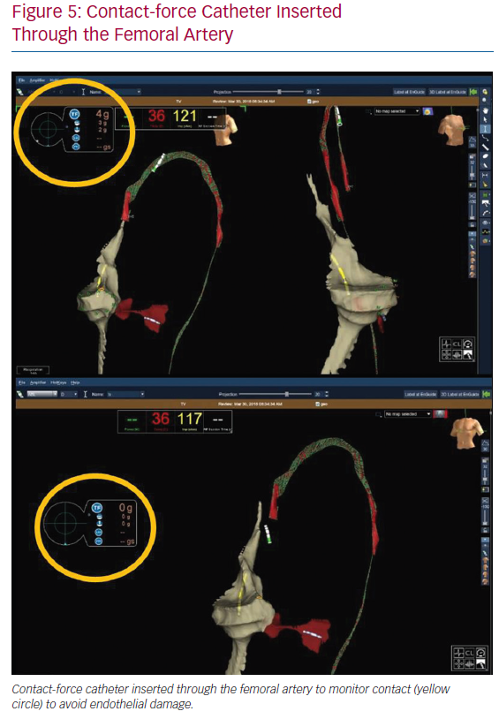
Mascia G, Giaccardi M
Contact-force Catheter Inserted Through the Femoral Artery
Citation: Arrhythmia & Electrophysiology Review 2020;9(3):121–7.
https://doi.org/10.15420/aer.2020.02

