Slide 1
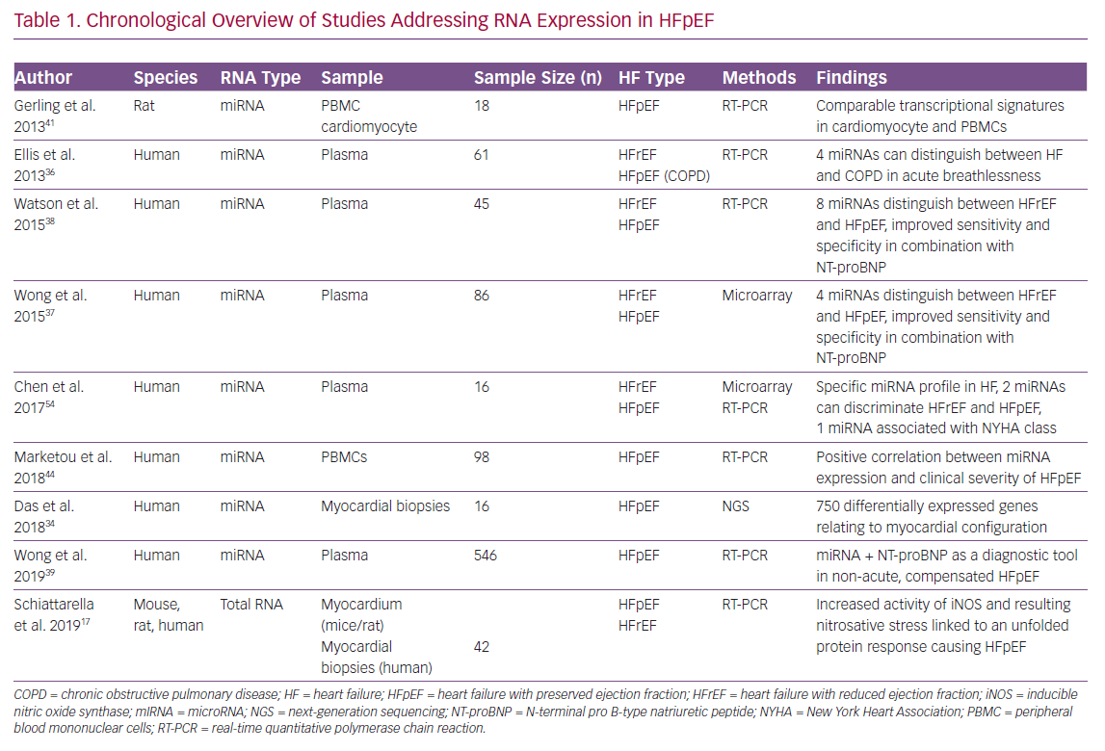
Rosch S, Rommel KP, Scholz M, Thiele H, Lurz P
Chronological Overview of Studies Addressing
Citation: Cardiac Failure Review 2020;6:e24.
https://doi.org/10.15420/cfr.2019.19

