Slide 1
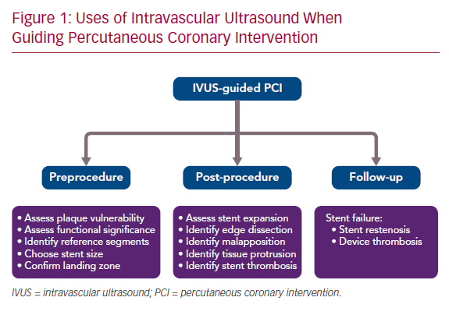
Intravascular Ultrasound-Guided Versus Angiography-Guided Percutaneous Coronary Intervention: Evidence From Observational Studies And Randomized Controlled Trials
Citation:

