Slide 1
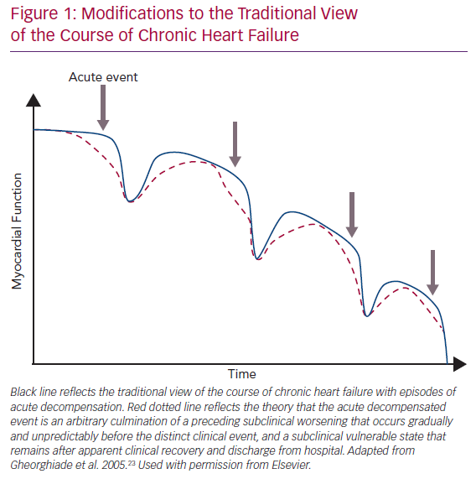
Kristjánsdóttir I, Lund LH
Modifications to the Traditional View of the Course of Chronic Heart Failure
Citation: Cardiac Failure Review 2020;6:e25.
https://doi.org/10.15420/cfr.2019.18

