Slide 1
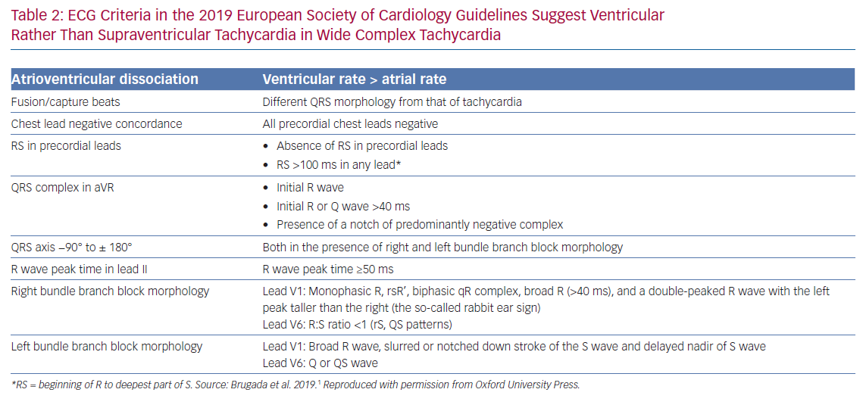
Katritsis DG, Brugada J
ECG Criteria in the 2019 European Society
Citation: Arrhythmia & Electrophysiology Review 2020;9(3):155–60.
https://doi.org/10.15420/aer.2020.20

