Slide 1

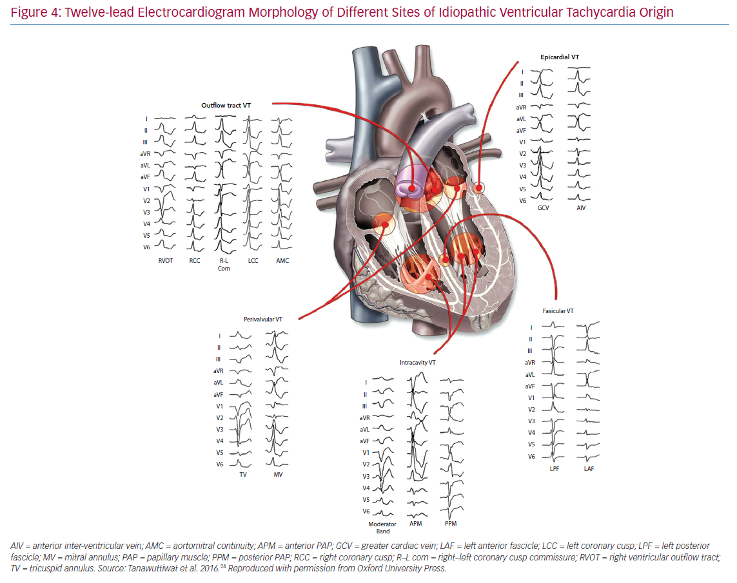
Katritsis DG, Brugada J
Twelve-lead Electrocardiogram Morphology
Citation: Arrhythmia & Electrophysiology Review 2020;9(3):155–60.
https://doi.org/10.15420/aer.2020.20

