Slide 1
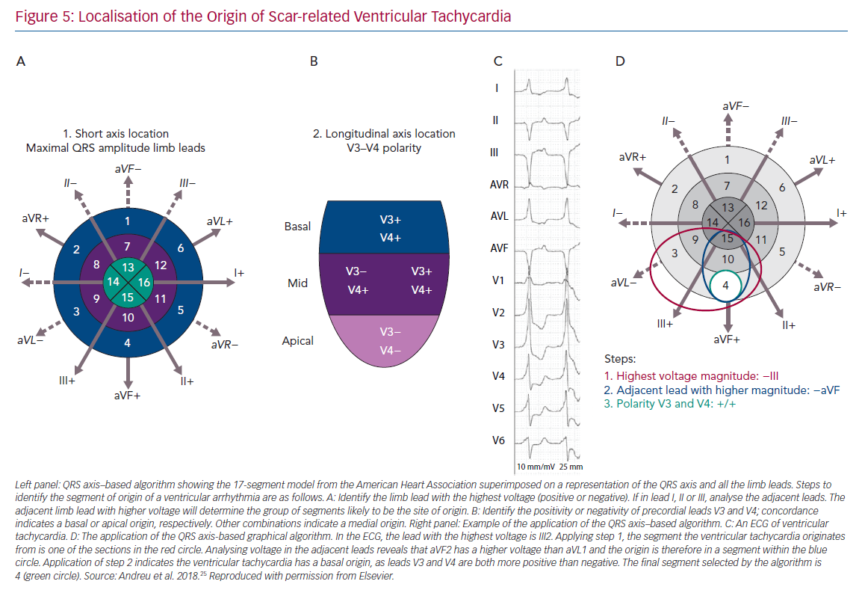
Katritsis DG, Brugada J
Localisation of the Origin of Scar-related Ventricular Tachycardia
Citation: Arrhythmia & Electrophysiology Review 2020;9(3):155–60.
https://doi.org/10.15420/aer.2020.20

