Slide 1
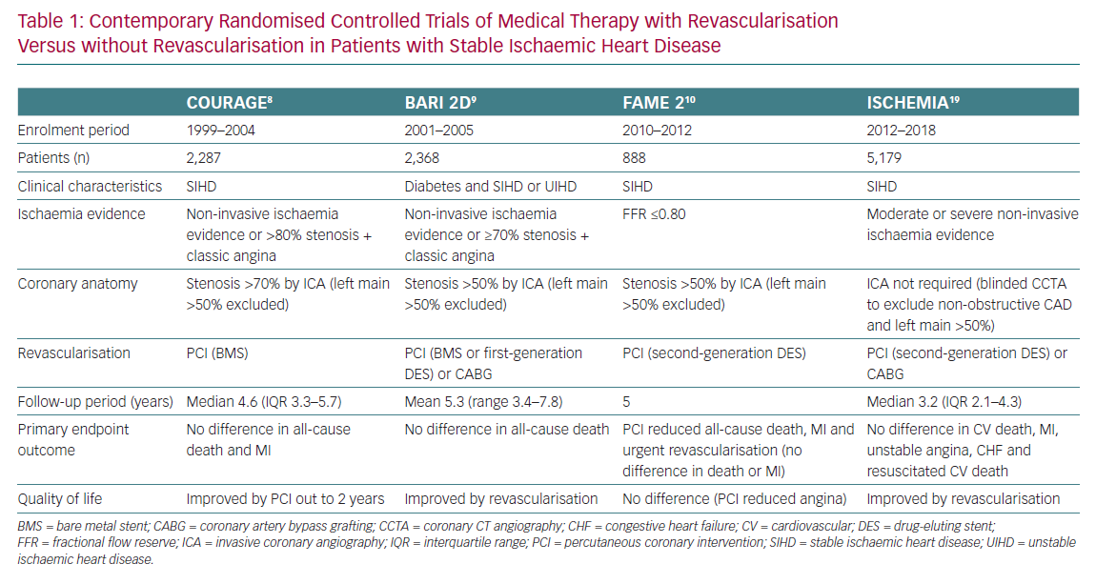
Mavromatis K, Boden WE
Contemporary Randomised Controlled Trials of Medical Therapy
Citation: European Cardiology Review 2020;15:e64.
https://doi.org/10.15420/ecr.2020.26

