Slide 1
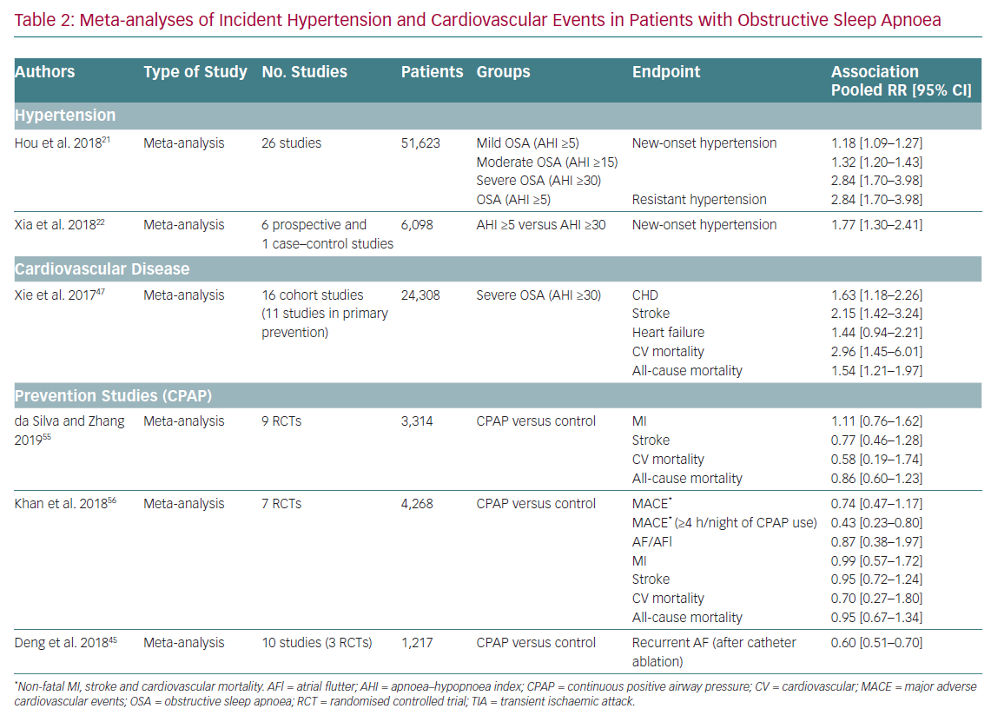
Resano-Barrio MP, Arroyo-Espliguero R, Viana-Llamas MC, Mediano O
Meta-analyses of Incident Hypertension
Citation: European Cardiology Review 2020;15:e65.
https://doi.org/10.15420/ecr.2020.10

