Slide 1
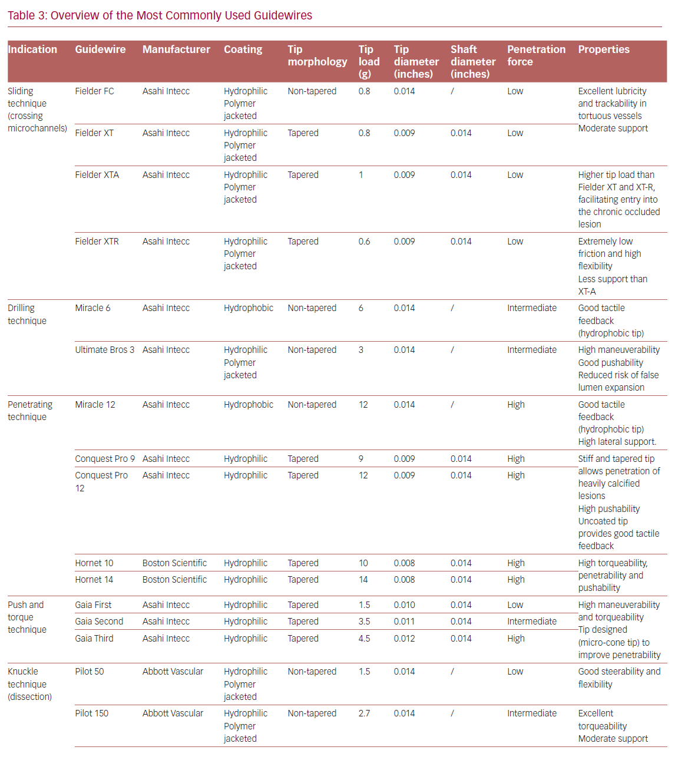
Vescovo GM, Zivelonghi C, Scott B, Agostoni P
Overview of the Most Commonly Used Guidewires
Citation: US Cardiology Review 2020;14:e11.
https://doi.org/10.15420/usc.2020.10

