Slide 1

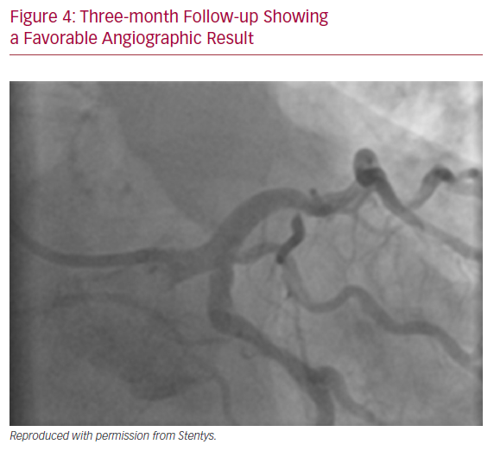
Pujdak K, Kähler J, Werner M
Three-month Follow-up Showing a Favorable Angiographic Result
Citation: US Cardiology Review 2020;14:e12.
https://doi.org/10.15420/usc.2020.11

