Slide 1
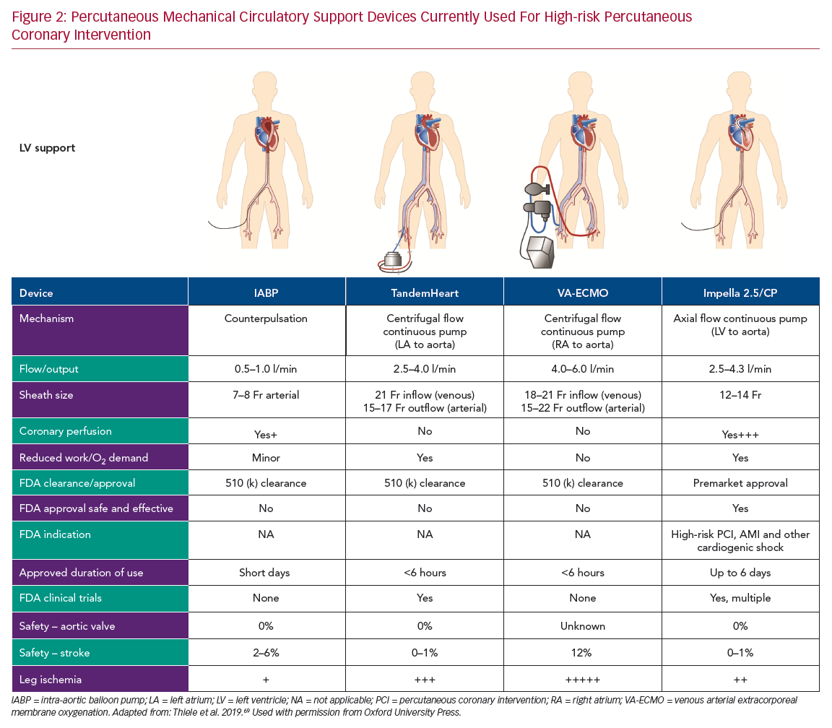
Simonton C, Thompson C, Wollmuth JR, Morris DL, Dahle TG
Percutaneous Mechanical Circulatory Support
Citation: US Cardiology Review 2020;14:e13.
https://doi.org/10.15420/usc.2020.18

