Slide 1
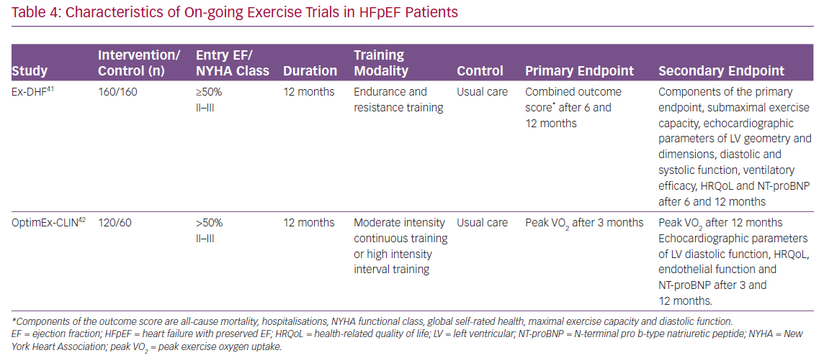
Fukuta H
Characteristics of On-going Exercise Trials in HFpEF Patients
Citation: Cardiac Failure Review 2020;6:e27.
https://doi.org/10.15420/cfr.2020.17

